Slide 1

Analysis of Electrical Consumption
Data set:
"Steel Industry Data“
Ethan Gueck | April 2024

Slide 2
Problem Framing and Big Picture

Slide 3
Data Exploration and Value-Add Information
The data set analyzed resembled meter information.
A couple of key attributes included Usage (kWh), Reactive Power Factors, and Date-Time information.
Based on industry standards and Department of Energy regulations, it was apparent that there were a significant number of examples where the Lagging Power Factor (PF), which is an indicator of system inefficiency, fell below the 90%-95% threshold.
Because of these observations, the following steps were taken to model the lagging power factor, thereby identifying the predictors or potential contributors to system inefficiency and building a system to predict future lagging PF based on those attributes.
Notes:
Meter information often contains time-series information and kWh.
References:
https://www.cedengineering.ca/userfiles/E04-014%20-%20Power%20Factor%20in%20Electrical%20Energy%20Management.pdf
https://www.ferc.gov/sites/default/files/2020-04/E-1_72.pdf

Slide 4
Methods and Procedure

Slide 5
Methods and Procedure
Considerations before modeling.
Multicollinearity: Several of the attributes appear to be inter-correlated.
Multi-dimensional data comprehension: With the relationships between the attributes being so prevalent, there is good reason to believe the data will present as polynomial when dimensions are increased in relationship to Lagging PF.
Polynomial relationships. Although most of the relationships between features seemed to be linear (i.e., as X increases Y increases, etc…), some of the relationships appear to me slightly more complicated, as discovered later in the modeling process.

Slide 6
Methods and Procedure
Data Preparation and Cleaning and Problem Framing
The dataset was surprisingly clean and required very little pre-processing.
The data was examined for correlation and form as demonstrated by figures 1.1 and 1.2.
After examining the data, it became evident that the lagging power factor contained numerous entries that fell below the industry standard and regulatory standard of ~ 95%.
After identifying this problem, it became clear that modeling this data as the target label could prove to be a high-impact value-added activity.
Notes:
Some transformations needed to be applied to the date column for modeling.
100% Power factor facilitates power factor unity.

Slide 7

Model the lagging power factor and investigate what contributes to a low power factor.
Problem Frame:

Slide 8
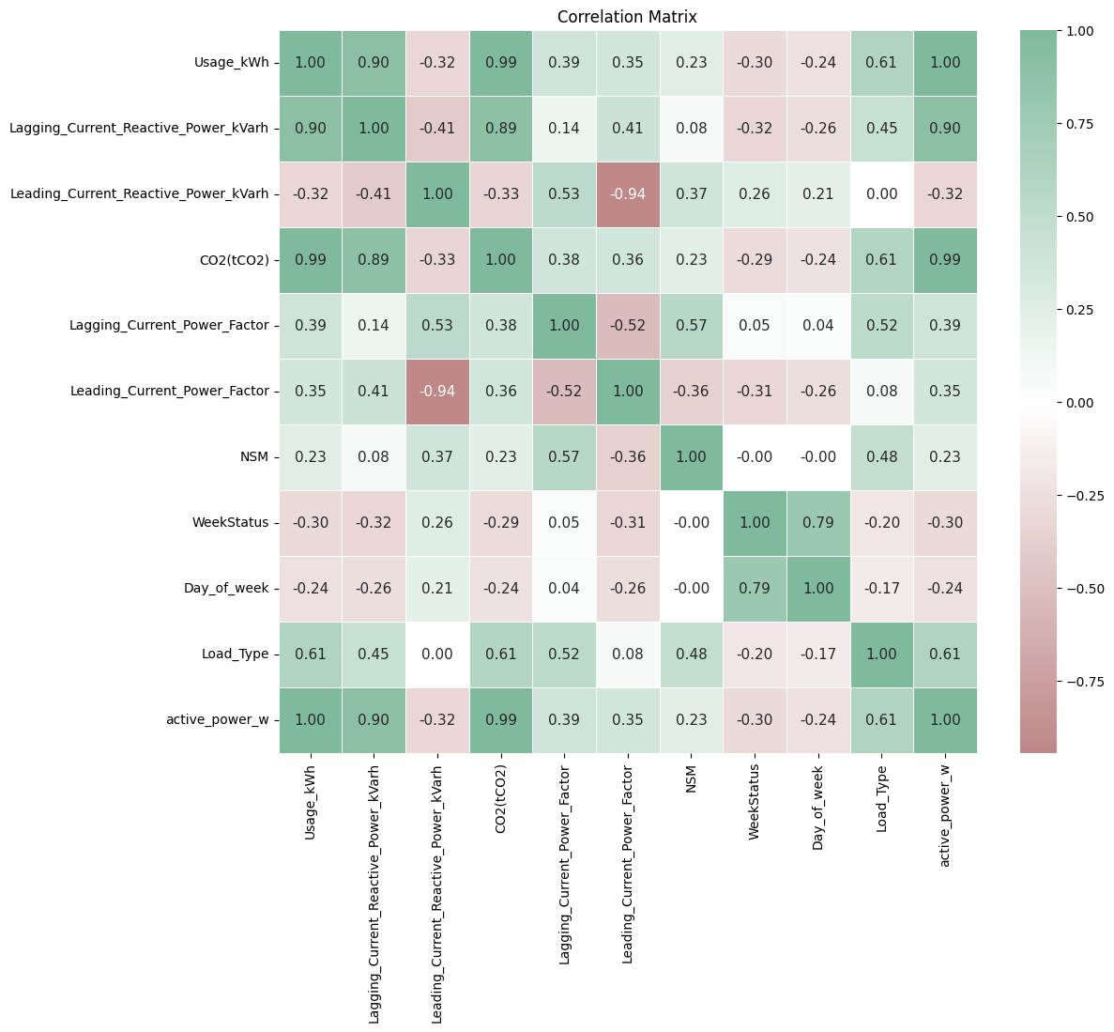
Methods and Procedure: Figure 1.1
Correlation
The lagging power factor is correlated to several attributes.
Active power: 39%
Load Type: 52%
Seconds from Midnight: 57%
Leading Power Factor – 52%
etc…

Slide 9
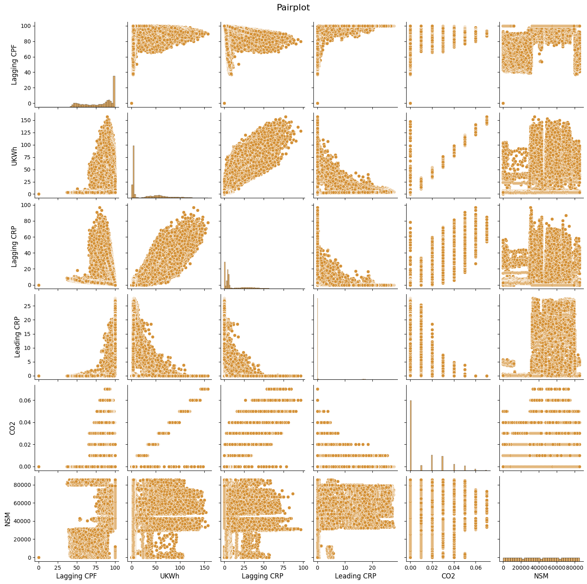
Methods and Procedure: Figure 1.2
Correlation
There are distinct relationships between the Lagging Power factor and each of the displayed attributes following similar relationships.
Seconds from midnight (NSM) has a distinct yet similar relationship to Lagging power factor as the other attributes in this visual.
Notes:
NSM – polynomial? The correlation between NSM and lagging power factor presents more as classification buckets. This is because NSM is discrete but the task is to model the power factor which is continuous.

Slide 10
Methods and Procedure
Model Selection and Testing
Based on the nature of the data expressed in the ‘Considerations before Modeling’ section three models were selected to predict the lagging power factor as presented below:
Ridge Regression Model
Random Forest Model
Gradient Boost Model
These models were each tested and ultimately the Random Forest Model was selected for the Final Model. (Figures 2.1 – 2.3)
Notes:
XGboost was also considered but ultimately rejected because the model is computationally taxing. Ultimately the final model performed very well so the question then becomes “is the juice worth the squeeze?”

Slide 11
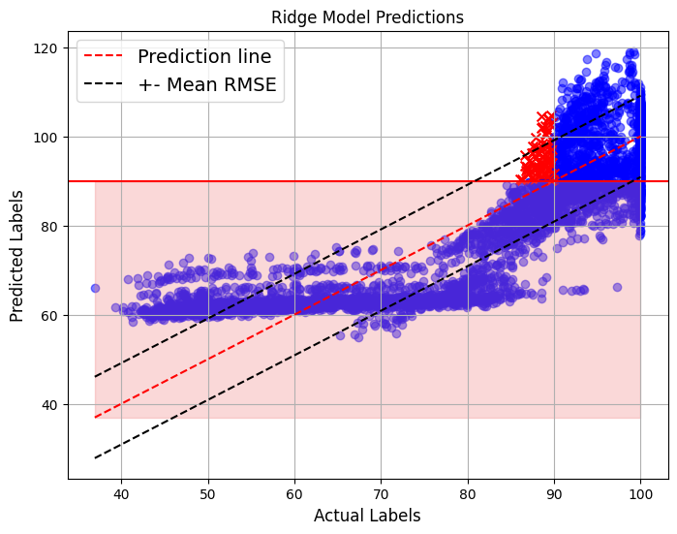
Methods and Procedure: Figure 2.1
Ridge Regression
The following are benefits of the ridge regression model:
Resilient to outliers.
Less likely to overfit.
Can handle polynomial relationships.
Can handle multicollinearity.
Can handle unscaled data.
Ultimately this model was not selected because the RMSE presented as 9.13 which severely underperformed relative to the other models.
The model predicted 97 entries as having a lagging power factor above 90% whereas the actual fell below 90%. (Validation predictions)
Notes:
The ridge regression clearly is producing some severely poor predictions, especially as the actual labels fall below 60%. Why is this? Hypothesis: data scaling and poor hyperparameter selection. Because Ridge regression short for “regularized” regression regularizes the coefficients towards 0 to reduce variance, I suspect that the alpha hyperparameter played the biggest role in this model’s performance.
Ridge regression model likely performed so poorly due to the lack of polynomial transformation.

Slide 12
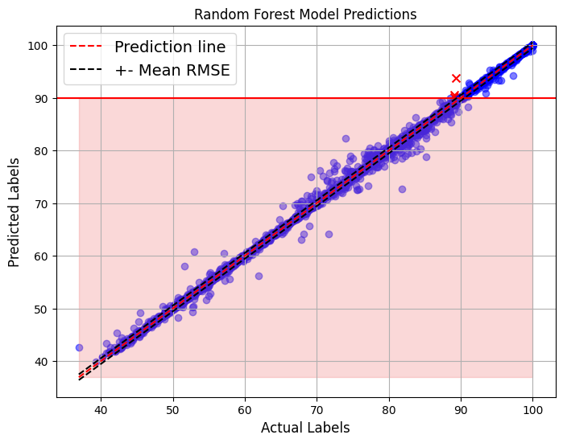
Methods and Procedure: Figure 2.2
Random Forest Model
The following are benefits of the ridge regression model:
Very resilient to outliers.
Less likely to overfit.
Can handle polynomial relationships.
Can handle multicollinearity.
Can handle unscaled data.
Ultimately this model was selected because the RMSE presented as 0.54 which outperformed the ridge and the gradient boost models.
The model only predicted 6 entries as having a lagging power factor above 90% whereas the actual fell below 90%. (Validation predictions)
Notes:
The random forest model performed well but there appears to be some cloudy data, particularly around the 80% centroid.

Slide 13
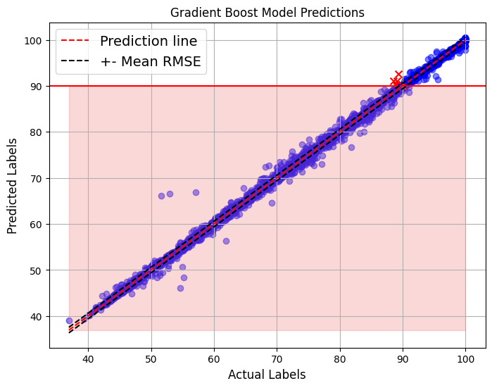
Methods and Procedure: Figure 2.3
Gradient Boost Model
The following are benefits of the ridge regression model:
Very resilient to outliers.
- Algorithmically complex.
- Can handle polynomial relationships.
- Can handle multicollinearity.
- Can handle unscaled data.
- Potential Issues:
- Sensitive to outliers; at risk of overfitting.
- Computationally taxing.
Ultimately this model was not selected because the RMSE presented as 0.60 underperformed relative to the random forest model.
The model predicted 14 entries as having a lagging power factor above 90% whereas the actual fell below 90%. (Validation predictions.
Notes:
The Gradient boost appears to have reduced some of that cloudiness or RMSE variance, however, there are some distant outliers. The model may have generalized better, but still was unselected for the reasons explained.

Slide 14
Methods and Procedure
Final Model Tuning and Implementation.
The final model selected was the Random Forest model because it outperformed the other two models and is computationally lighter than the gradient boost model.
Although each model underwent a grid search, the final model was tunned by running another grid search using the following hyperparameters:
'max_depth’: [17, 18, 19]
'n_estimators’: [125, 150, 175]
'min_samples_split’: [2, 3]
The Final Model performance is presented in Figure 3.1, and the predictions are represented in Figure 3.2.

Slide 15

Methods and Procedure: Figure 3.1
Final Random Forest Model
The following hyperparameters were the optimal hyperparameters as identified by the final model grid search.
'max_depth’: 19,
'n_estimators’: 150
'min_samples_split’: 2
The final model RMSE was 0.5513.
The final model predicted 6 entries as having a lagging power factor above 90% whereas the actual fell below 90%. (Validation predictions.

Slide 16
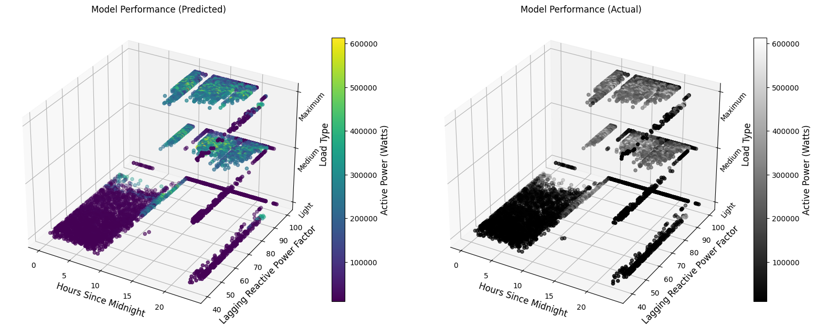
Methods and Procedure: Figure 3.2
Final Random Forest Model
This figure compares the predicted values with the actual values plotted against the following attributes.
Hours from Midnight (Captures 24-hour period and is a conversion of the ‘NSM’ attribute.
Lagging Power Factor.
Load Type.
Stylized by the Active Power Usage.
Notes:
Take note of the very interesting relationship between load type, time of day, and lagging power factor. A SME may be able to quickly identify weaknesses in the system using this visual.
Take note of the “hot-spots” Hovering around 80-90% lagging power factor.
Very interesting the relationship between low usage and low power factor and power unity and low usage.
Were this to be presented to a technical team, the data could also be visualized by month, which may indicate some level of seasonality.

Slide 17
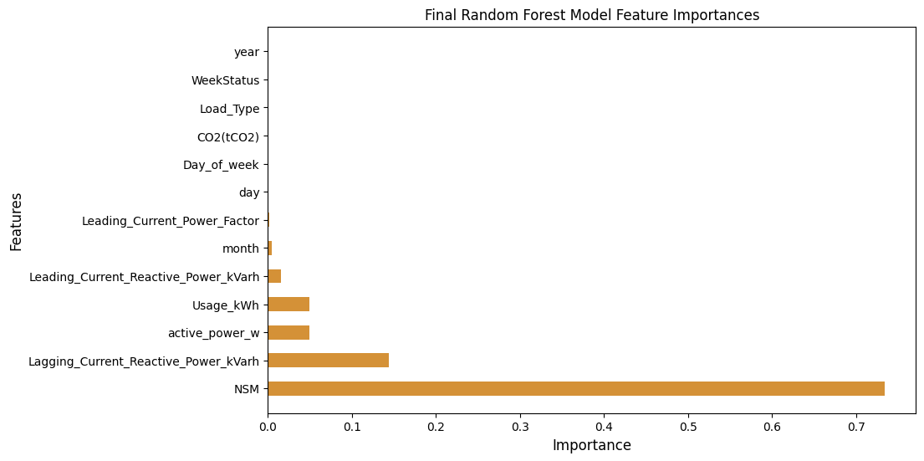
Methods and Procedure: Figure 3.3
Final Random Forest Model
The following attributes are the major predictors and their weight in predicting the final model.
Seconds from midnight. (NSM) : >70%
Lagging Reactive Current ~ 15%
Active Power (watts) & Usage (kWh): Each ~7%
Notes:
Month is not mentioned here since it is a low-value predictor, but it is a predictor nonetheless and should not be discounted.

Slide 18
Results and Discussion

Slide 19
Summary of Results
EDA showcased that 41% of the usage had a lagging power factor that fell below 90%.
The lagging power factor is an indicator of system inefficiency thereby prompting exploration and modeling.
The random forest model progressed as the final model with an RMSE of only 0.5513.
The final random forest model performed very well; on average the model only had an inaccuracy that deviated the test Lagging Power Factor by ~0.5% out of 100%
Additionally, only 6 data points were predicted as exceeding the 90% threshold when they were actually below 90%.

Slide 20
Recommendations and Insights
The Seconds from Midnight, Lagging Reactive Current, Active Power (watts) & Usage (kWh): each are major predictors of the lagging power factor.
It is recommended that further exploration be conducted on whether the lagging power factor is most prevalent during transmission or delivery.
What are the root causes of the system inefficiencies?
It is recommended that further exploration be conducted to understand whether the active power is heavily affected by the lagging power factor.
Lastly, no polynomial transformation was conducted on the features, which is likely a leading cause of the poor performance in the ridge model. It may be valuable to consider implementing a polynomial feature transformation for the ridge regression modle in future implementations.

Slide 21
Future Research
Future research should focus on the following additional insights:
Model the time series relationship to the lagging power factor and active power.
The month appears to be a prospective predictor.
Model the CO2 produced by the system as it can further indicate system inefficiency.
Future model improvement should consider the following:
Selecting either the usage attribute or active power as a predictor (redundant information).
Dropping the lagging reactive power (redundant information).
Further hyperparameter testing and additional model testing (i.e, Xgboost.)

Slide 22
Appendix

Slide 23
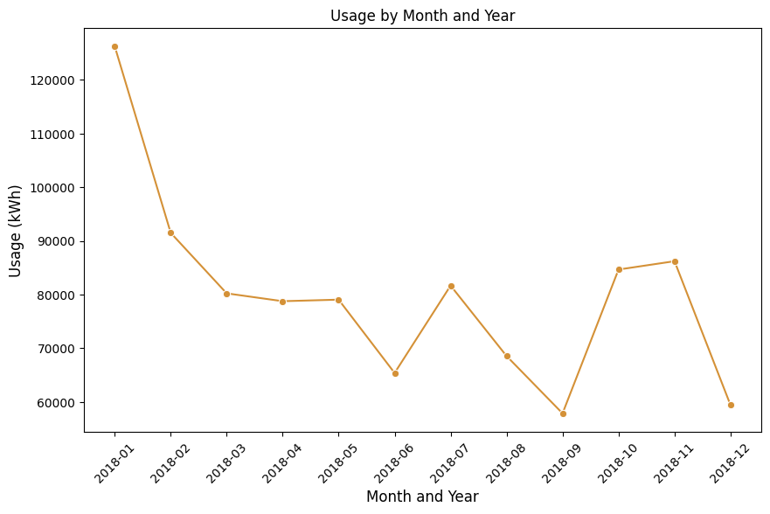
Appendix: Figure 0.1
Visual of usage plotted by date.
Usage follows a very interesting sinusoidal or polynomial curve that intuitively aligns with seasons.

Slide 24
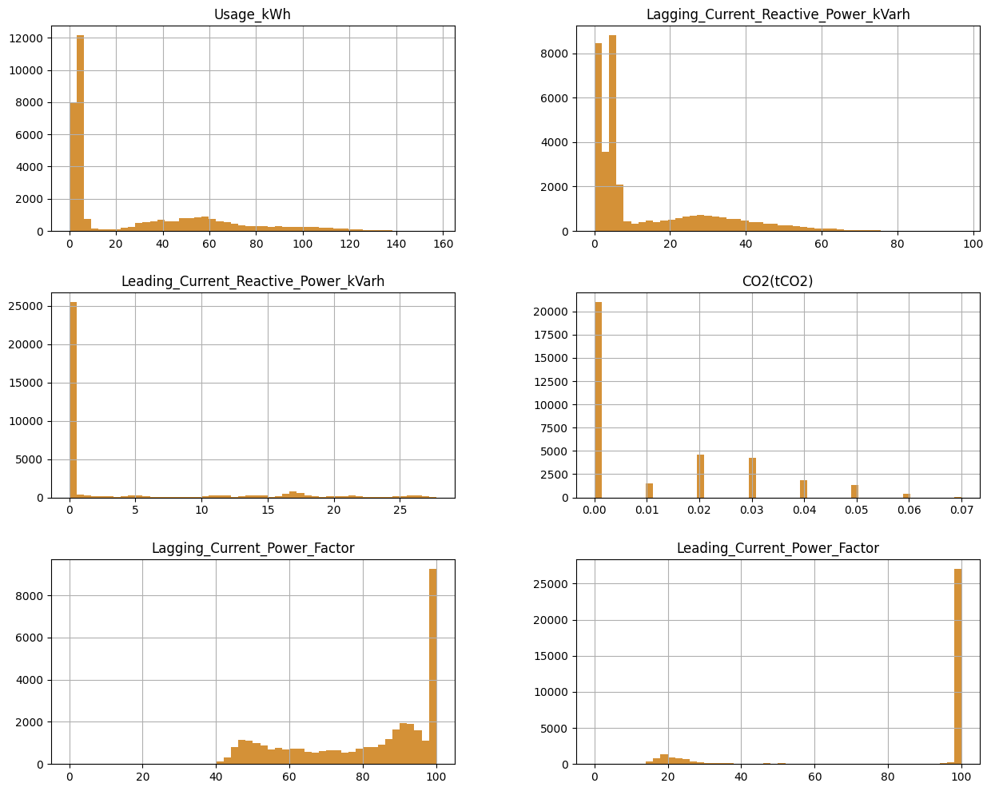
Appendix: Figures 0.2
Plot of distribution for a segment of attributes.
Plot does not represent all features.

Slide 25
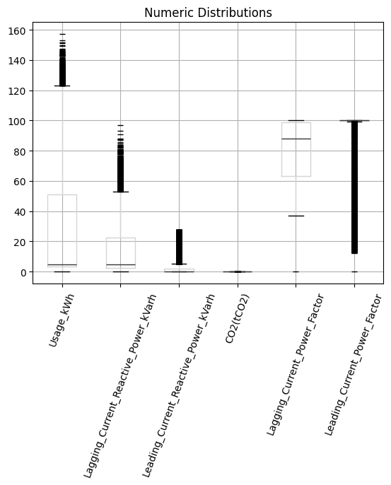
Appendix: Figures 0.3
Box plot of numeric attributes for a segment of attributes.
Plot does not represent all features.
A significant number of outliers are distributed throughout a wide range whereas most of the data resides close to the mean for each of the attributes plotted.

Slide 26
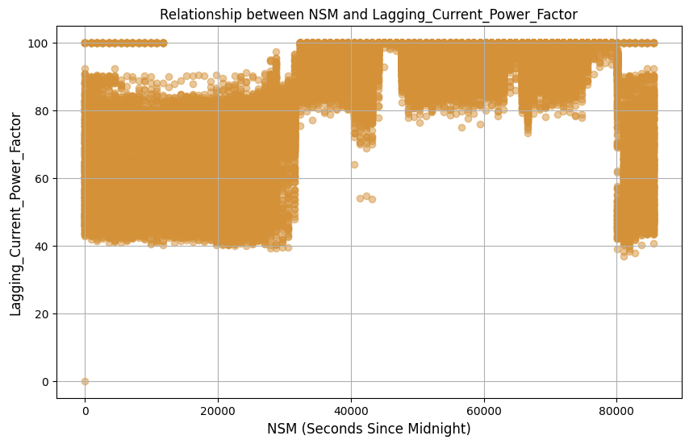
Appendix: Figures 0.3
Scatter plot of Lagging power factor and seconds from midnight.
Notice the sinusoidal or polynomial nature of the relationship.

Slide 27
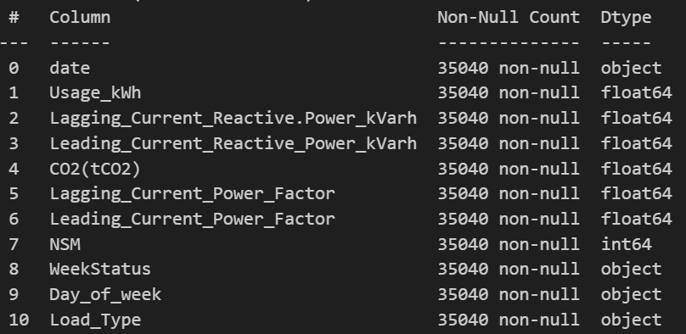
Appendix: Table 0.1
Data content:
All attributes are not null and do not appear to have coded null values.
Table contains ordinal, categorical, and numeric data.
Models implemented did not require ordinal or numeric encoding.

Slide 28
Appendix: Table 0.2
Data content:
41% of usage was associated with a lagging power factor of less than 90%.

Slide 29
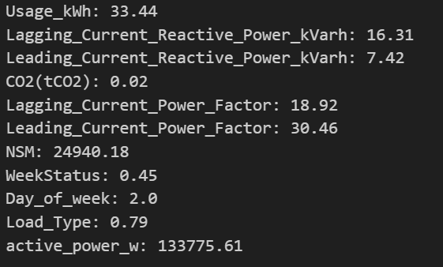
Appendix: Table 0.2
Data content:
This visual contains the features and their standard deviations.

Slide 30
End of Presentation.
References:
https://control.com/technical-articles/active-power-reactive-power-apparent-power-and-the-role-of-power-factor/#:~:text=Active%20power%20is%20often%20called,power%20factor%20in%20DC%20circuits.
https://www.electrical-installation.org/enwiki/Definition_of_reactive_power#:~:text=Apparent%20power%3A%20S%20%3D%20V%20x%20I%20(kVA)
https://www.ferc.gov/sites/default/files/2020-04/E-1_72.pdf
https://www.federalregister.gov/documents/2024/03/28/2024-06556/compensation-for-reactive-power-within-the-standard-power-factor-range#:~:text=As%20a%20result%2C%20all%20newly,as%20a%20condition%20of%20interconnection.
https://www.electricaltechnology.org/2013/07/active-reactive-apparent-and-complex.html
https://eepower.com/technical-articles/power-factor-determining-how-much-electricity-your-power-system-consumes/#
https://www.cedengineering.ca/userfiles/E04-014%20-%20Power%20Factor%20in%20Electrical%20Energy%20Management.pdf

Slide 31
This slide is intentionally left blank.

